Slide 1
Managing System Components
Configure Localization Options
Configure GUIs
Manage Services
Troubleshoot Process Issues
Troubleshoot CPU and Memory Issues

Slide 2

Topic A: Configure Localization Options
Exam Objectives:
1.6 Given a scenario, configure localization options.

Slide 3
Localization
The process of adapting OS components for use within a distinct culture, other than the initial culture they were designed for.
Usually includes:
Translating interface into a language.
Converting measurements between regional systems.
Configuring keyboard layout.
Setting date and time.
Important to localize Linux services provided to international users.
Example: Admin in Japan working on system in Japanese.

Slide 4
The /usr/share/zoneinfo/ Directory (Slide 1 of 2)
A container for all regional time zones available on system.
Subdirectories organize language by region.
Africa includes files for countries/cities within continent.
Individual time zone files are special.
Not raw text.
Used by system.
Create symbolic link to zone file to /etc/localtime file.
One way to set system time zone.

Slide 5
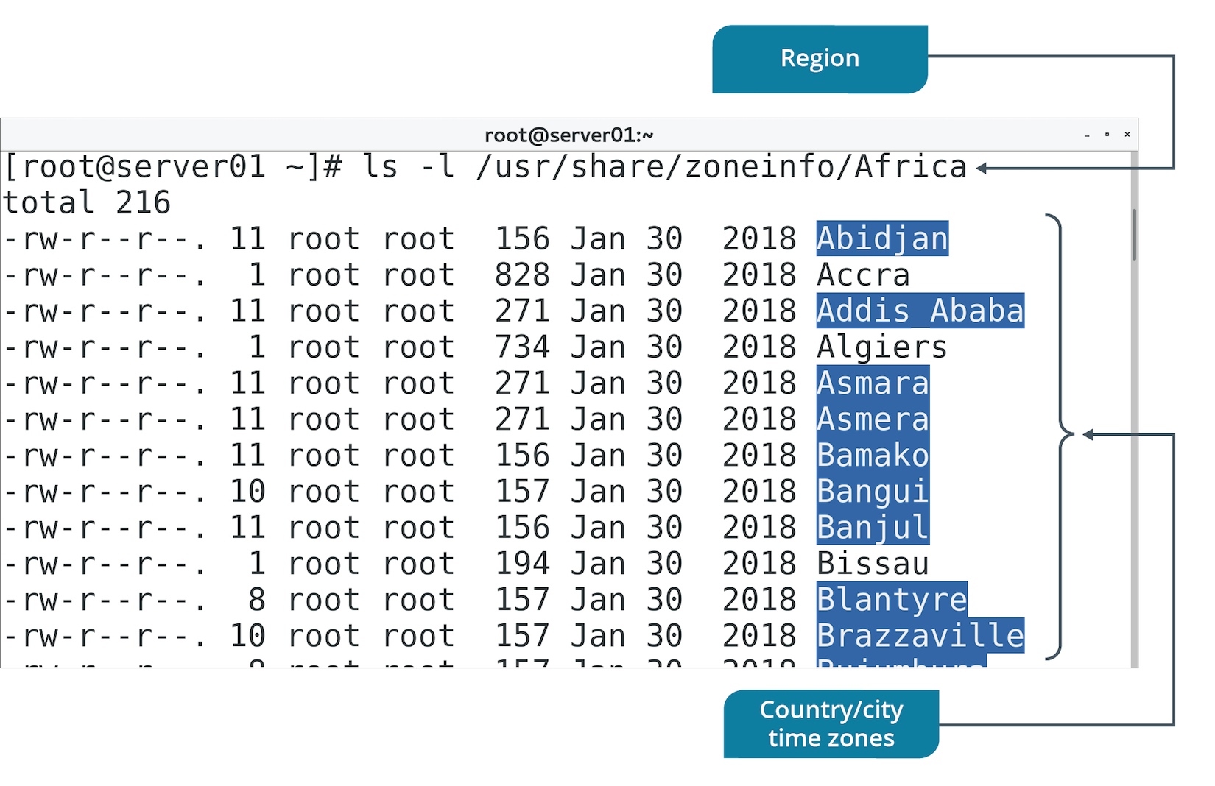
The /usr/share/zoneinfo/ Directory (Slide 2 of 2)

Slide 6
The /etc/timezone File
Used in Debian-based distros.
Displays current system time zone.
Lists zone by region structure in /usr/share/zoneinfo
Example: Europe/Berlin

Slide 7
The date Command (Slide 1 of 2)
Prints date in specified format.
Based on /etc/localtime file.
Default format example:
Wed Oct 31 15:03:16 GMT 2018
Can also format date with different options.
Example: date +%V to print week of the year.
Can also use -s option to set date.

Slide 8
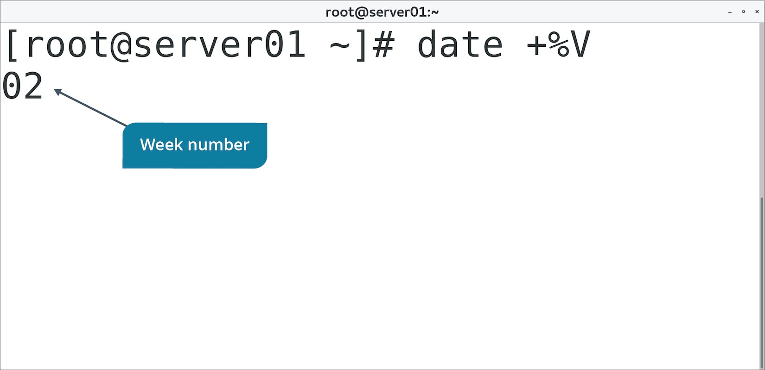
The date Command (Slide 2 of 2)

Slide 9
The timedatectl Command (Slide 1 of 2)
Sets system date and time info using subcommands.
Subcommand | Used To
status | Show current date and time info.
set-time | Set system time to time provided.
set-timezone | Set system time zone to time zone provided.
list-timezones | List all available time zones.
set-ntp {0|1} | Enable or disable NTP server synchronization.

Slide 10
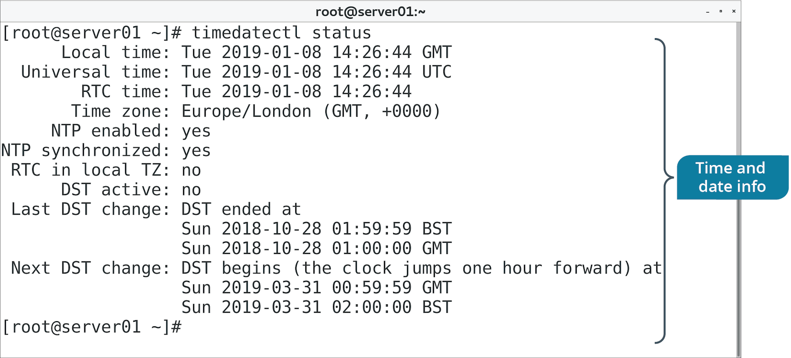
The timedatectl Command (Slide 2 of 2)

Slide 11
The hwclock Command
View and set hardware clock.
Recommended to keep hardware clock at UTC.
Can also adjust systematic drift.
Predictable amount of time the clock gains/loses each day.
Makes clock inaccurate, misaligned with system clock.
/etc/adjtime file records when and by how much hardware clock is changed.
hwclock consults file to identify drift value.
hwclock can correct clock's time.

Slide 12
The localectl Command (Slide 1 of 2)
View and configure system locale/keyboard layout.
Locale determines how to represent cultural differences.
Language, date/time format, money format, etc.
Keyboard layouts can be configured independently of locale.
Determines how physical key presses are interpreted by system.
Subcommand | Used To
status | Show current locale and keyboard layout.
set-locale | Set system locale to locale provided.
list-locales | List all available locales.
set-keymap | Set keyboard layout to provided layout.
list-keymaps | List all available keyboard layouts.

Slide 13
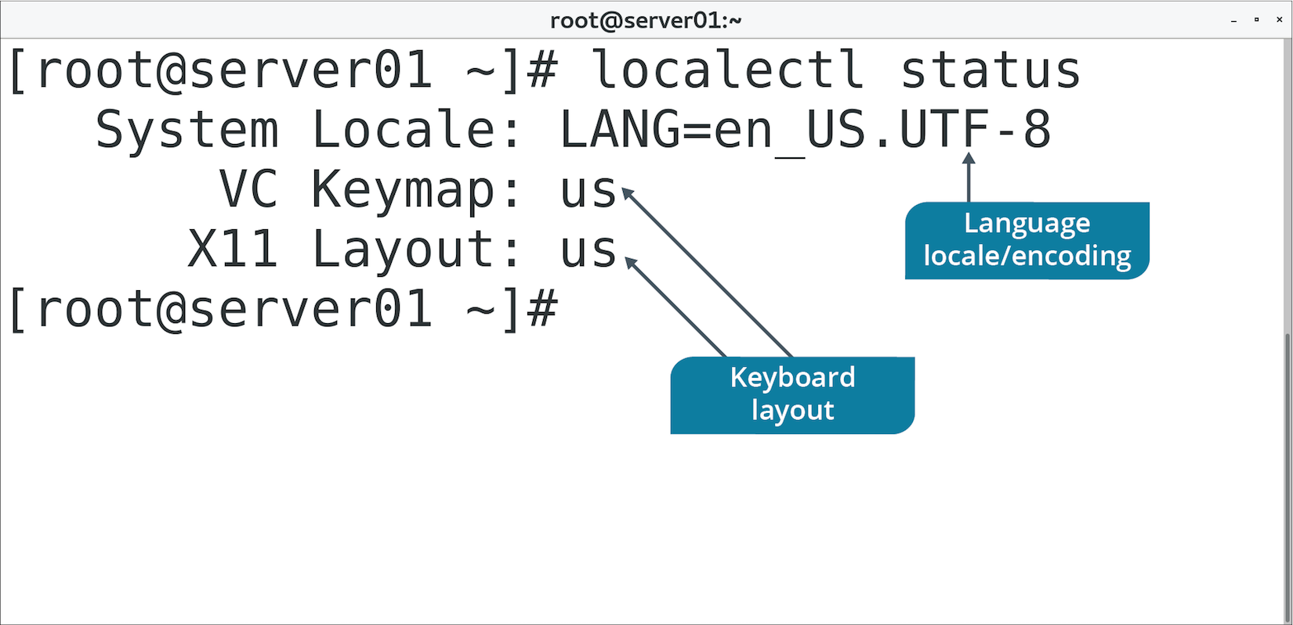
The localectl Command (Slide 2 of 2)

Slide 14
Character Sets and Encoding
Encoding: Converting text to bytes.
Decoding: Converting bytes to text.
Intermediary process between human and machine.
Default on most systems is UTF-8 with Unicode character set.
Capital letter C is at Unicode positional number U+0043
UTF-8 encodes 43 in binary (01000011).
Some software uses older encoding like ASCII.
Text may appear garbled if wrong encoding used.
Linux locale settings determine encoding to use.
de_DE.utf8 and de_DE.iso88591 are same locale but different encoding.

Slide 15
Discussing Localization Options

Slide 16
Activity 8-1: Discussing Localization Options
The date command is very powerful, especially for use in scripts. You can add timestamps to log files and to script output. How can you display the day, date, and time using the date command?
ANSWER:
date +"%A %F %X" —The date command by itself also produces similar output.

Slide 17
Activity 8-1: Discussing Localization Options
You recently moved several Linux server systems from your local data center in the Eastern U.S. time zone to a disaster recovery data center in the Central U.S. time zone. You need to change time zones for those systems. What steps can you take to change the time zones?
ANSWER:
Use sudo timedatectl list-timezones to find the correct format for the new time zone, which is America/Chicago. Use sudo timedatectl set-timezone America/Chicago to set the time. Check the setting with sudo timedatectl status

Slide 18
Activity 8-1: Discussing Localization Options
Your company has deployed physical systems in its data centers rather than virtual ones. Physical systems often experience some time drift if not calibrated with an external source, such as an NTP server. You should set the hardware clock to UTC and also correct any time differences by telling the hardware clock to compensate for drift. How can you set the hardware clock and adjust for drift?
ANSWER:
sudo hwclock -u sets the clock to UTC and sudo hwclock --adjust compensates for drift.

Slide 19
Activity 8-1: Discussing Localization Options
Your company is global in scope and you have systems in data centers in several different countries. Often while typing you discover that some odd characters appear on the screen. One of your counterparts in one of the offshore countries informs you that they have changed the keymap to better suit their needs. How can you change the keymap for U.S. compatibility?
ANSWER:
localectl set-keymap us —You can set your keymap as a regular user.

Slide 20
Activity 8-1: Discussing Localization Options
Why would you need to change the locale settings of a system based on its global location?
ANSWER:
A system's locale determines how it will represent various culture-specific elements, the most prominent of which is the language used in the interface. However, a locale can also determine factors such as how date and time are formatted, how monetary values are formatted, and more.

Slide 21
Activity: Configuring Localization Options
A colleague in London needs remote access to a server.
Server is in US but services users in Great Britain.
You'll set time zone to London and localization options to Great Britain.
Will make it easier for colleague to work in environment.
Will ensure server has correct time.
Notes:
Teaching Tip: If this course is being taught using classroom computers located in Great Britain, consider having the students change their localization options to the US or some other English-speaking region.
Teaching Tip: Students will learn more about environment variables in a later lesson.

Slide 22
Topic B: Configure GUIs
Exam Objectives:
2.8 Compare and contrast Linux graphical user interfaces.

Slide 23
GUIs (Slide 1 of 2)
A type of user interface in which users interact with a system or application through visual design elements.
As opposed to CLI, which is pure text.
Linux GUIs are similar to other OS GUIs.
Selecting icons representing objects.
Configuring options through menus.
Interacting with apps through windows.
Working from a desktop.
Optional and usually applied to non-server roles.
Add extra layer of overhead.
Not suitable in servers where performance is paramount.
Some admins prefer to have a GUI available.
GUIs can emulate CLI, so you can use both.

Slide 24
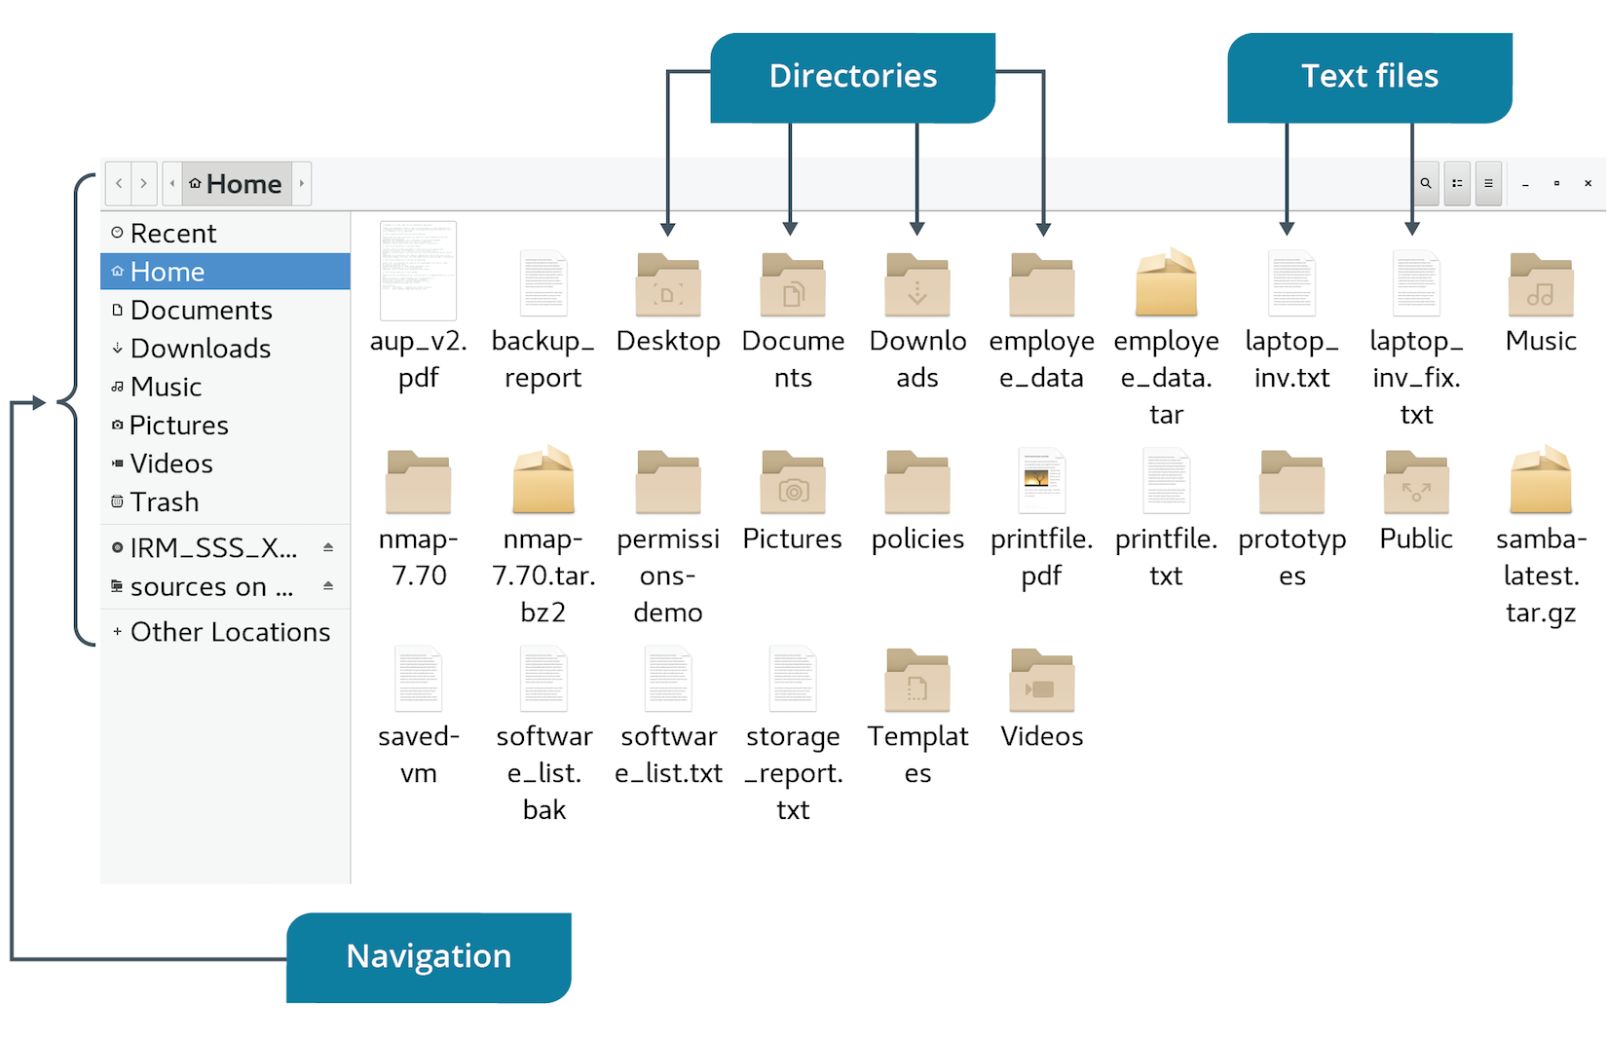
GUIs (Slide 2 of 2)

Slide 25
Display Servers
The component of a GUI that constructs and manages visual elements on the screen.
Accept client input requests.
Forward input to kernel for processing.
Also receive output display requests from apps to send to client.
Manage communication over network-aware protocol.
Remote clients can access GUI elements like windows.
Still provide services locally.
Linux supports many types.
X Window System and Wayland are most prominent.

Slide 26
The X Window System (Slide 1 of 2)
A platform-independent display server and windowing system.
Developed by MIT in 1984.
Coordinates client input and app output to determine how to draw screen.
X server communicates with separate compositor.
Compositor reads memory buffer each app writes to.
Compositor uses buffer info to combine each app window on screen.
X server receives event and informs compositor.
Compositor must re-composite part of screen affected by event.
Notes:
Teaching Tip: Consider letting students know that, in the Linux world, a capital "X" almost always refers to the X Window System.

Slide 27
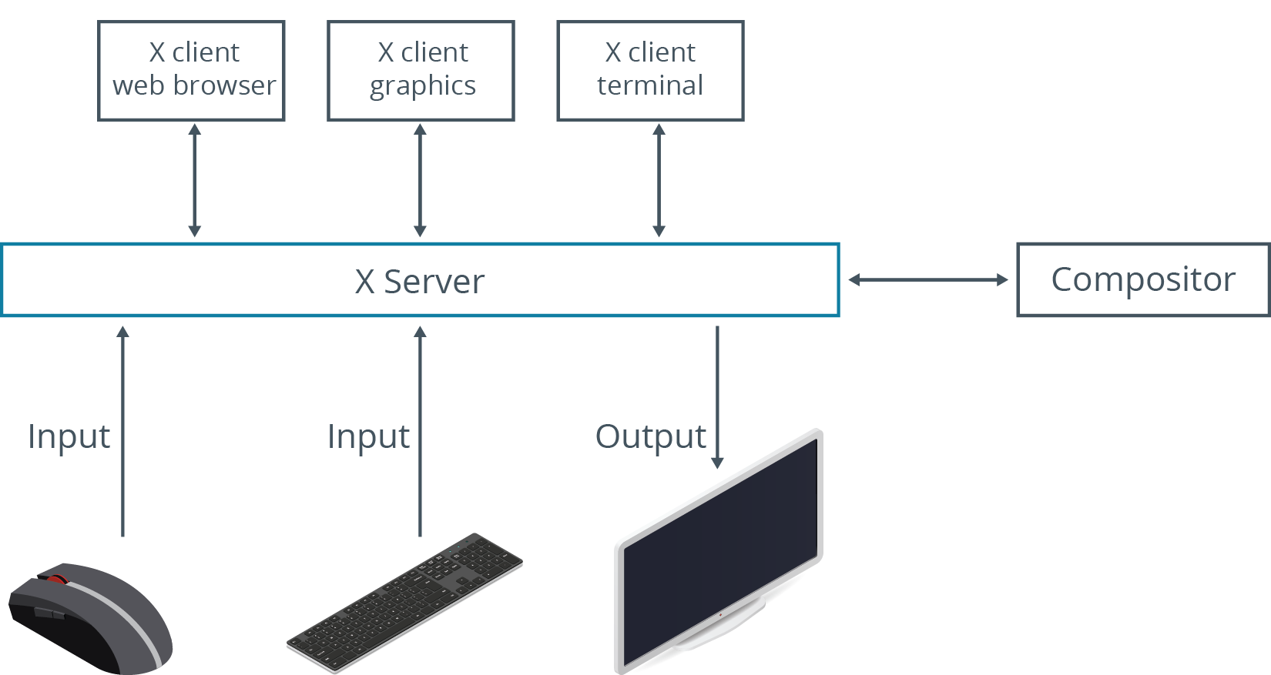
The X Window System (Slide 2 of 2)

Slide 28
X.Org Server
A free and open source reference implementation of the X Window System for Linux and other Unix-like operating systems.
Released in 2004.
Quickly became de facto display server for Linux distros.
Prior to 2004, XFree86 was the implementation of X used in Linux.
Changed to GPL-incompatible custom license.
Forked into X.Org Server.

Slide 29
Wayland (Slide 1 of 2)
A display server and reference implementation in Unix-like operating systems meant to replace X.
Improves upon X in many ways.
Compositor and server are one in Wayland.
Client can exchange events directly with compositor.
X server is no longer middle man.
Released in 2008.
Adoption has been slowly increasing.
Fedora 25 started using Wayland as default.

Slide 30
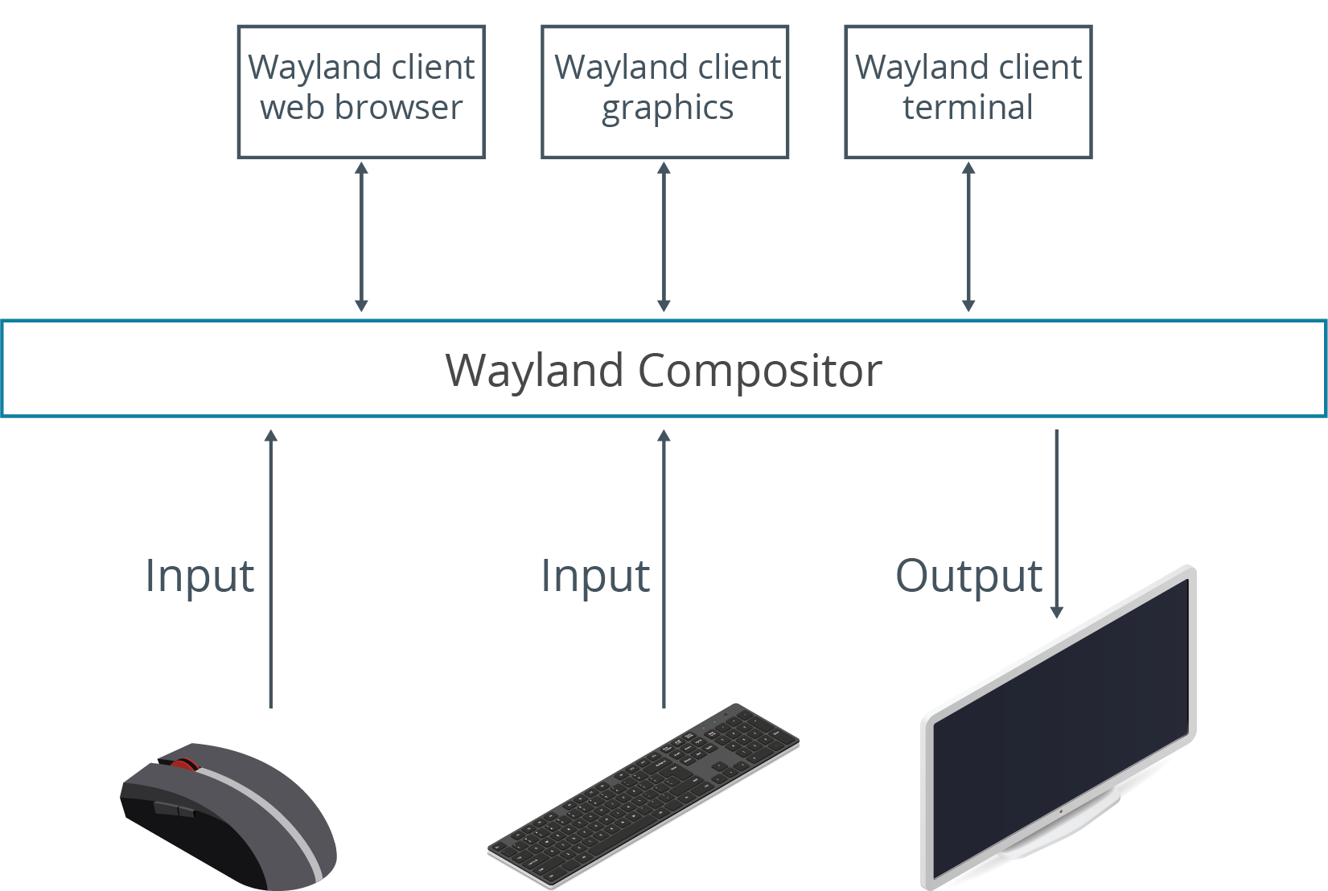
Wayland (Slide 2 of 2)

Slide 31
X vs. Wayland
In Wayland:
Compositor can easily determine what window an event applies to.
Latency issues with fetching data are mitigated.
Rendering is offloaded to client, simplifying the process.
Remote desktop protocols can still be leveraged for network access to GUI.
Data I/O of each window isolated, improving security.

Slide 32
Desktop Environment (Slide 1 of 2)
A client to a display server that tells the server how to draw graphical elements on the screen.
Controls look and feel of GUI for entire OS.
Provides common graphical interface for apps.
Implements desktop metaphor.
Monitor is treated as a physical desktop.
Objects are on top of desk, accessible to person sitting at desk.
Primary structural element is the application window.
In window can be buttons, icons, menus, etc.
Also provides login screen.
Can be set to run every time system boots.
Also come packaged with apps.

Slide 33
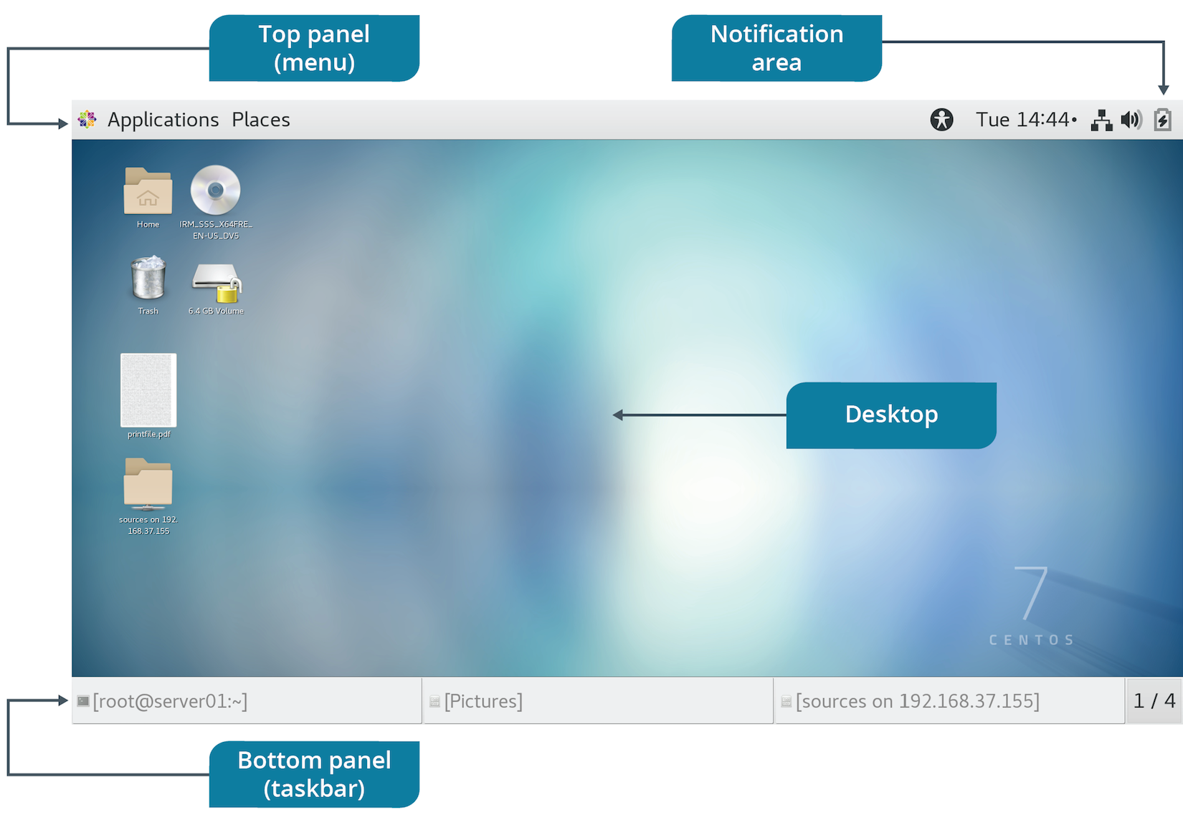
Desktop Environment (Slide 2 of 2)

Slide 34
Specific Desktop Environments
Desktop Environment | Description
GNOME | Default in most distros. Follows human interface guidelines for design. Robust accessibility settings. GNOME Shell with version 3 uses an abstracted metaphor. GNOME Classic emulates desktop metaphor of GNOME 2. Unity shell was used in Ubuntu at one point. Supports X and Wayland.
KDE Plasma | Second-most common environment; optional in some distros. Supports modularity through widgets. Robust GUI apps. Supports X and Wayland.
Cinnamon | Fork of GNOME 3 and one default for Linux Mint. Uses desktop metaphor; similar to GNOME 2. No Wayland support.
MATE | Fork of GNOME 2 to maintain and extend functionality. Other default for Linux Mint. No Wayland support.
Notes:
Teaching Tip: Consider having students search Google for more Linux desktop environments, if they're interested.

Slide 35
Remote Desktop
A concept in which a client connects to a remote system over a network, and is able to use its desktop environment.
Useful when you need to configure a remote server with a GUI.
You aren't physically located at server.
Also for users to work with a remote system as if it were their primary one.
Client computer constructs remote session in a window.
When window has focus, it sends input to remote desktop.
Remote system accepts input as if performed directly.

Slide 36
Remote Desktop Software
Remote Desktop Software | Description
VNC | Cross-platform; based on RFB protocol. Server installed on remote machine; can be accessed with client. Many different implementations. Works with X and Wayland.
xrdp | FOSS that constructs RDP-like server for non-Windows systems. Use rdesktop or default client to connect. Designed to work with X.
NX | Cross-platform and proprietary. Supports multi-session environments; useful in large organizations. Designed to work with X.
SPICE | FOSS for use in virtual environments. Often used to connect to VMs using KVM.

Slide 37
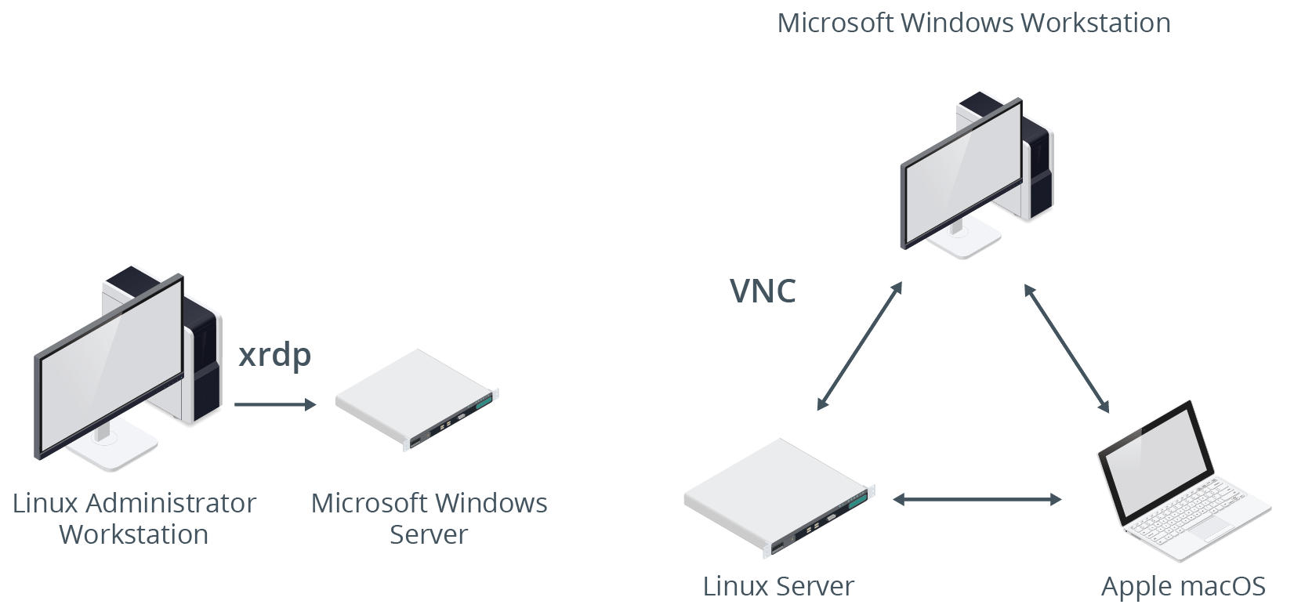
VNC and xrdp

Slide 38
Console Redirection
The process of forwarding input and output through a serial connection.
System can send display output to remote client over serial cable.
Client can send keyboard input to remote system over serial cable.
Enables admins to remotely configure BIOS/UEFI.
Without an OS loaded, typical remote access will not work.
Configure pre-boot systems that don't have physical I/O devices.

Slide 39
SSH Port Forwarding
SSH is a remote access protocol that encrypts data over a network.
Commonly used to access CLI on a Linux server.
Can also be used as a tunnel for apps like remote desktop.
Tunneling is called SSH port forwarding.
Local:
Client listens for connections on a port; tunnels connections to remote server.
Example: Connect to VNC server with client; traffic over port 5900 is forwarded through SSH.
Remote:
Server forwards inbound traffic to another system on a port.
Example: Server forwards VNC traffic to client; client connects to port on localhost.

Slide 40
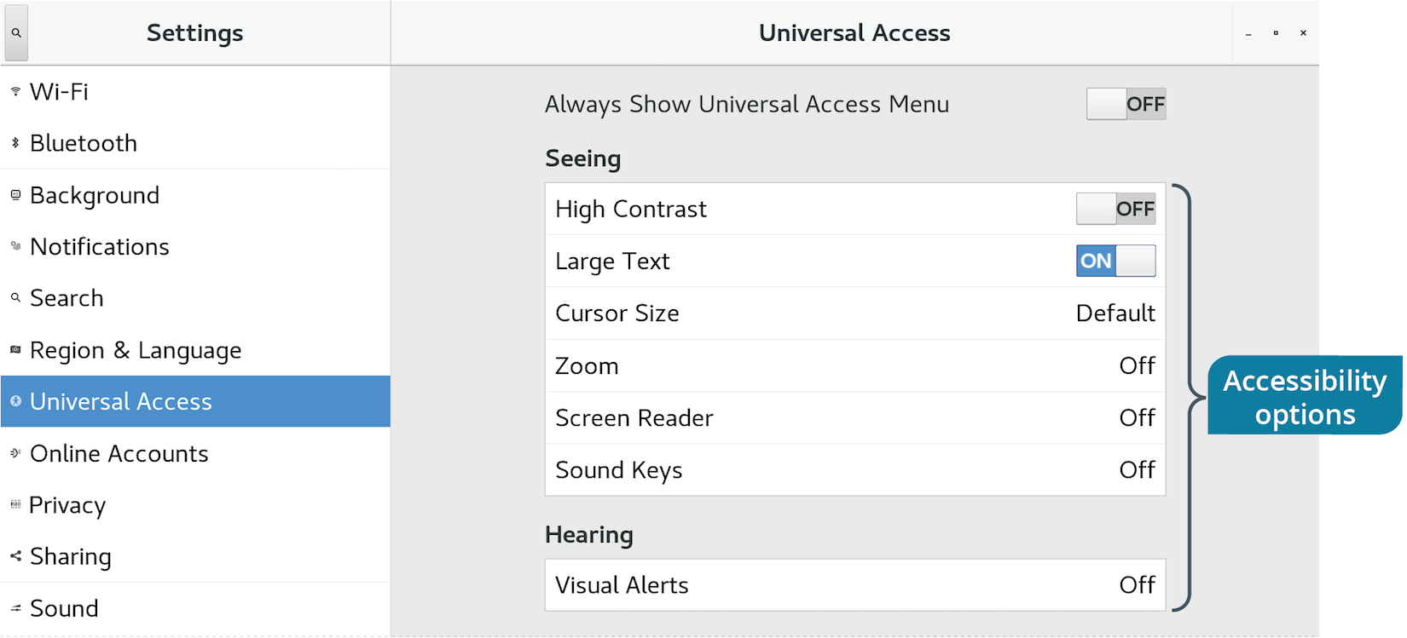
Accessibility Options (Slide 1 of 2)

Slide 41
Accessibility Options (Slide 2 of 2)
Screen reader
Magnifier
Increasing size of screen elements
On-screen keyboard
Keyboard accessibility options
Sticky keys
Repeat keys
Toggle keys
Visual themes like high contrast

Slide 42
Discussing GUIs

Slide 43
Activity 8-3: Discussing GUIs
True or false? A graphical desktop environment is required for most administrative activities, such as creating new users and installing new software.
ANSWER:
False. In fact, in most enterprises, the GUI is not installed at all.

Slide 44
Activity 8-3: Discussing GUIs
What is the primary architectural difference between the X and Wayland display servers? How does this difference affect performance?
ANSWER:
In X, the compositor is separate from the display server. In Wayland, the compositor and display server are one. The Wayland compositor can therefore interact directly with clients, minimizing latency.

Slide 45
Activity 8-3: Discussing GUIs
Where can you, as a user, switch to a different graphical user interface (KDE to GNOME, for example)?
ANSWER:
At the graphical login screen.

Slide 46
Activity 8-3: Discussing GUIs
At a foundational level, many remote desktop protocols (e.g., NX, xrdp, SPICE, VNC) are not designed to be highly secure. How can you make them more secure?
ANSWER:
By tunneling through SSH.

Slide 47
Activity 8-3: Discussing GUIs
Why would an administrator need or use console redirection?
ANSWER:
Without an operating system on the hardware, an administrator needs some method of connecting to a "bare metal" system. Console redirection is that method.

Slide 48
Activity: Configuring GUIs
Many colleagues prefer working in a visual environment.
GUI is also necessary for web browsing and media viewing.
Some users want to use a customized KDE.
You'll configure layout options for KDE.
Most users want to use GNOME.
You'll navigate GNOME to become familiar with it.
You'll set accessibility options in GNOME for users with disabilities.
Notes:
Teaching Tip: The mouse might be sluggish at first, but should become more responsive after a few moments.

Slide 49
Topic C: Manage Services
Exam Objectives:
2.4 Given a scenario, manage services.
4.1 Given a scenario, analyze system properties and remediate accordingly.

Slide 50
Services and Daemons
Service: Software that responds to request from other programs.
Provides specialized functionality.
Can be critical or non-critical.
Typically implemented as daemons.
Daemon: Programs that run in the background.
No user intervention necessary.
Lie dormant until triggered.
Can operate at regular intervals.
Can be started by system, apps, or users.

Slide 51
Service Management
The lifecycle process of starting services, modifying their running state, and stopping them.
System can manage services itself.
Users can manage services manually.
Enables admins to configure server functionality.
Also used to troubleshoot issues related to running programs.

Slide 52
System Initialization
The process that begins when the kernel first loads.
Involves loading of OS and components.
Including boot process.
Carried out by init daemon on Linux.
Initiates processes from config file.
Prepares system to run software.
Runs continuously and must stay running until shutdown.
Two methods on Linux: SysVinit and systemd.
Affects how you manage services.

Slide 53
The systemd Suite
A software suite that replaces older init methods like SysVinit.
Also provides tools for service management.
Dominant in modern Linux distros.
Example improvements:
Supports parallelization.
Reduces shell overhead.
Control Groups are better at isolating/categorizing processes.

Slide 54
systemd Unit Files (Slide 1 of 2)
Configuration files systemd uses to determine how to handle units.
Units are system resources systemd can manage.
Network services, devices, file systems, etc.
Daemons manage resources.
Defined in categories.
Extension determines category (e.g., .automount).
Written in declarative language.
Can exist in multiple locations.
Default is /lib/systemd/system
Replace files in /etc/systemd/system
Create .d directory with unit file's name and .conf file in that directory for granular editing.
Notes:
Teaching Tip: Environment variables are discussed in a later lesson.

Slide 55
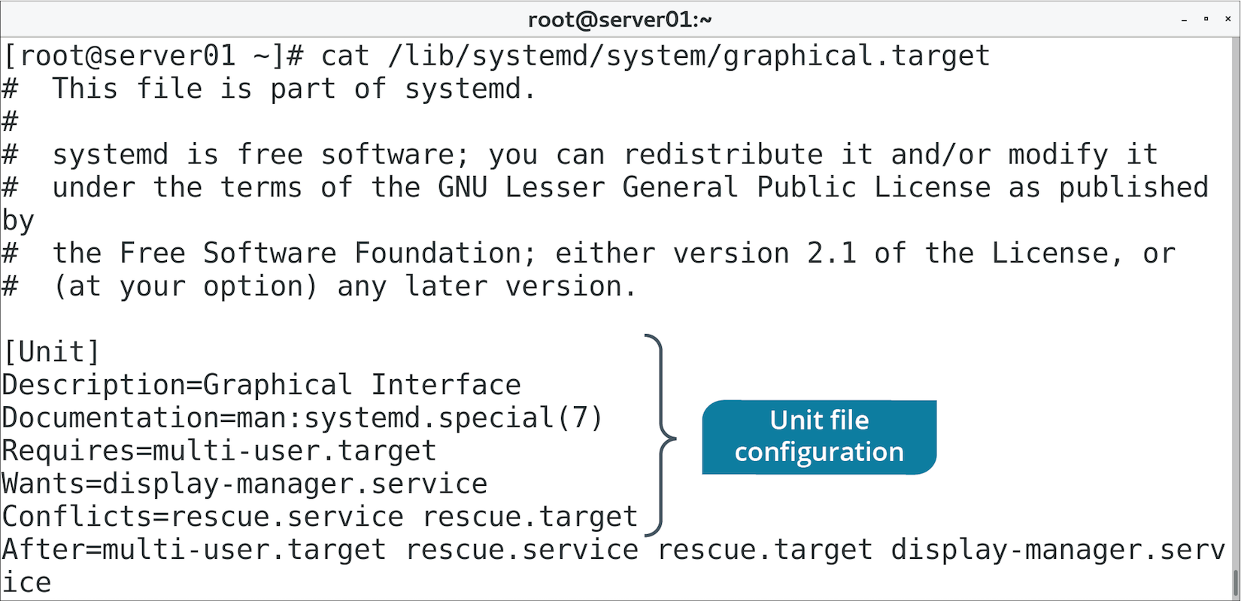
systemd Unit Files (Slide 2 of 2)

Slide 56
systemd Targets (Slide 1 of 2)
A method of grouping unit configuration files together.
Typically used to represent modes of operation.
Each .target file determines one of several ways system can operate.
Running with CLI.
Running with GUI.
Shutting down.
And more.
Use targets to boot into desired environment.
Targets include dependency info.
Required for booting into chosen environment.
Example: graphical.target initializes other unit files like gdm.service

Slide 57
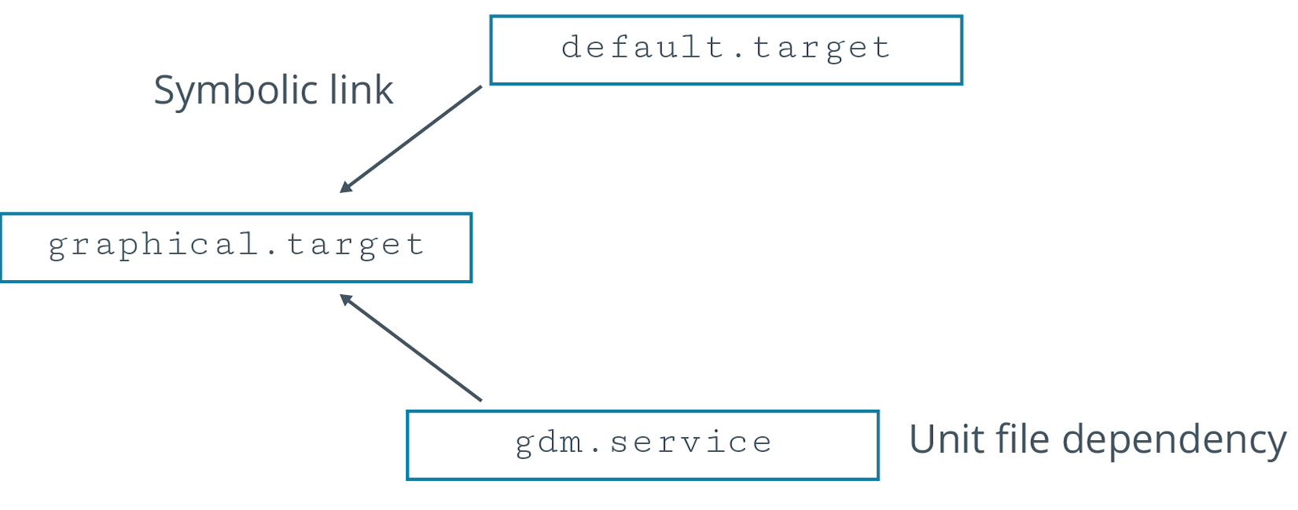
systemd Targets (Slide 2 of 2)

Slide 58
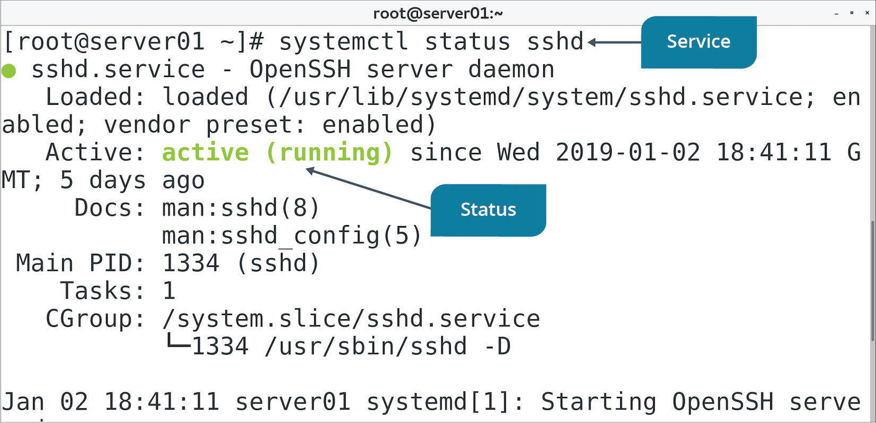
The systemctl Command (Slide 1 of 2)
Used to control systemd init daemon.

Slide 59
The systemctl Command (Slide 2 of 2)
Subcommand | Used To
status {service} | Retrieve service status.
enable {service} | Enable service to start on boot.
disable {service} | Disable service so it doesn't start on boot.
start {service} | Activate service immediately.
stop {service} | Deactivate service immediately.
restart {service} | Restart service immediately.
set-default {target} | Set default target for system to use on boot.
isolate {target} | Force system to immediately change to target.
mask {unit file} | Prevent unit file from being enabled or activated.
daemon-reload | Reload daemon and all unit files.

Slide 60
Example of Switching Targets
You might want to work with GUI temporarily, but return to CLI after.
Process:
Start to multi-user.target by default.
Log on to CLI and switch to GUI: systemctl isolate graphical.target
Complete admin tasks.
Return to CLI: systemctl isolate multi-user.target

Slide 61
SysVinit and Runlevels
SysVinit is older init method superseded by systemd.
Some distros still support it.
Provides tools to manage services and state of system.
Includes runlevels.
Similar to systemd targets.
Control state of system.
Determine what daemons run.
You can change runlevel and set a default.

Slide 62
Runlevels vs. Targets
SysVinit Runlevel | systemd Target | Description
0 | poweroff.target | Shuts down system.
1 | rescue.target | Starts single-user mode.
2 | multi-user.target | Starts multi-user mode without remote networking.
3 | multi-user.target | Starts multi-user mode with networking.
4 | multi-user.target | Not used.
5 | graphical.target | Starts multi-user mode with networking and GUI.
6 | reboot.target | Reboots system.
Notes:
Teaching Tip: Consider pointing out the most prominent targets, particularly multi-user.target and graphical.target.

Slide 63
The telinit and runlevel Commands
telinit enables you to switch current runlevel.
Will be translated to target request on systemd.
runlevel command prints previous and current runlevel.
Separated by a space.

Slide 64
The /etc/inittab File
Stores details of processes related to SysVinit.
Stores details of runlevels.
The init daemon reads from file to determine:
What runlevel to boot.
What daemons to start.
What to do if runlevel changes.
Entry format:
id:rstate:action:process

Slide 65
The /etc/init.d/ Directory
Stores initialization scripts for services.
Scripts control initiation of services for a runlevel.
Invoked from /etc/inittab during initialization.
Scripts are flexible and can be configured.
Some distros store scripts in /etc/rc.d/

Slide 66
The chkconfig Command
Control services in each runlevel or start/stop services on boot.
Subcommand/Option | Used To
{service} on | Enable service to start on boot.
{service} off | Disable service so it doesn't start on boot.
{service} reset | Reset the status of service.
--level {runlevel} | Specify runlevel in which to enable or disable service.

Slide 67
The service Command
Another way to control SysVinit services.
Subcommand | Used To
{service} status | Print current state of service.
{service} start | Activate service immediately.
{service} stop | Deactivate service immediately.
{service} restart | Restart service immediately.
{service} reload | Re-read config files while service runs.

Slide 68
Discussing Services

Slide 69
Activity 8-5: Discussing Services
After installing the Apache web server, httpd, you want to check its status. How can you check the status of the httpd service?
ANSWER:
sudo systemctl status httpd.service

Slide 70
Activity 8-5: Discussing Services
How can you activate a service such as httpd?
ANSWER:
sudo systemctl start httpd.service

Slide 71
Activity 8-5: Discussing Services
You want to be sure that the Apache web server starts on boot. Which command can you use to ensure that it starts?
ANSWER:
sudo systemctl enable httpd.service

Slide 72
Activity 8-5: Discussing Services
What is the SysVinit equivalent of systemctl enable httpd.service?
ANSWER:
sudo chkconfig httpd on

Slide 73
Activity 8-5: Discussing Services
You made a change to the /etc/httpd/conf/httpd.conf file and saved it, but the change you made hasn't taken effect. What is the problem and how do you fix it?
ANSWER:
The service needs to be restarted so the configuration file can be re-read and the changes applied: sudo systemctl restart httpd.service

Slide 74
Activity: Managing Services
You need to configure services at Develetech using systemd.
You'll start by switching targets from CLI to GUI.
You'll set GUI as default so users will always boot into it.
You'll manage the service lifecycle for SSH and the firewall.
Notes:
Teaching Tip: Students will work more with the SSH and firewall services later in the course.

Slide 75
Topic D: Troubleshoot Process Issues
Exam Objectives:
2.4 Given a scenario, manage services.
2.6 Given a scenario, automate and schedule jobs.
4.2 Given a scenario, analyze system processes in order to optimize performance.

Slide 76
Common Process Issues
Hangs, causing instability on process.
Hangs, consuming resources.
Hangs, causing general system sluggishness.
Terminates before it can perform tasks.
Fails to terminate when not needed.
Should be allocated more CPU resources.
Causing system to take longer to boot.
Has a file open, preventing modification of file.
Spawns multiple child processes that are hard to manage.
Is unidentifiable or potentially malicious.

Slide 77
Process States
Process go through a lifecycle.
Five states within lifecycle.
Define how system and apps can interact with process.
Can help you diagnose problems.
Can help you determine what to do with a process.
States:
Running
Interruptible sleep
Uninterruptible sleep
Zombie
Stopped

Slide 78
Process IDs (Slide 1 of 2)
A unique integer assigned to each new process when it starts.
Used by system/users to identify process.
Non-negative integer that increases.
The init daemon always has a PID of 1
First process to start; parent of all.
Processes that start after init are assigned a higher number.
Need to know PID to manage a process.

Slide 79
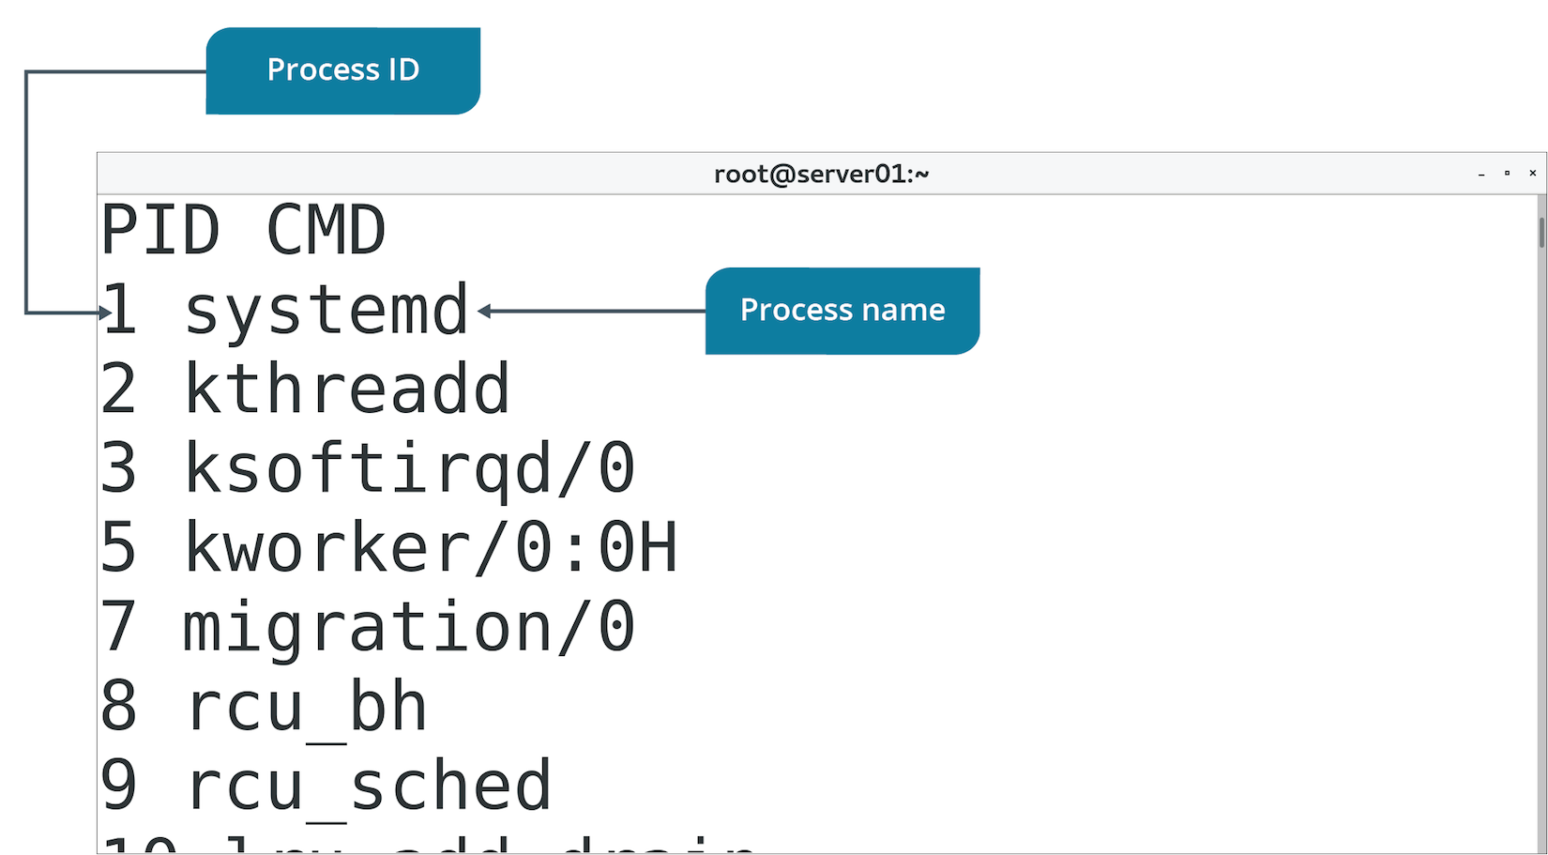
Process IDs (Slide 2 of 2)

Slide 80
The pgrep Command (Slide 1 of 2)
Displays PID of process matching a pattern.
Similar to grep
Patterns:
Name/UID of invoking user.
Start time.
Parent PID.
And more.
Use to identify process when you don't know its PID.
Often the first step in troubleshooting/managing process.

Slide 81
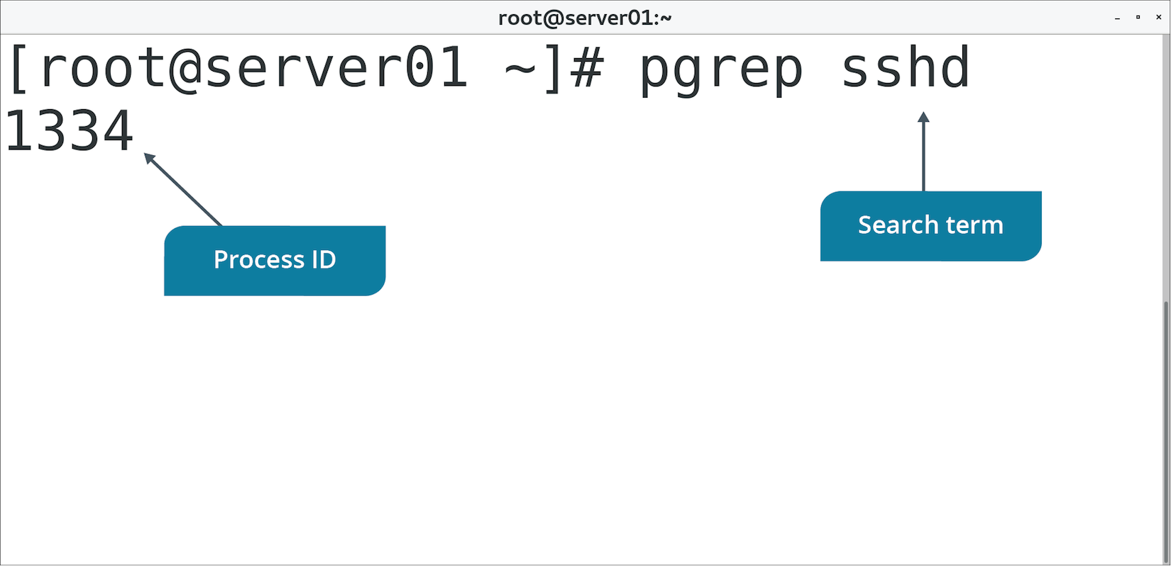
The pgrep Command (Slide 2 of 2)

Slide 82
The ps Command (Slide 1 of 2)
Invokes process table.
Summarizes current running processes.
Without options, displays processes run by current shell.
Details like PID, terminal, CPU time, etc.
Options can be used to filter displayed fields/processes.

Slide 83
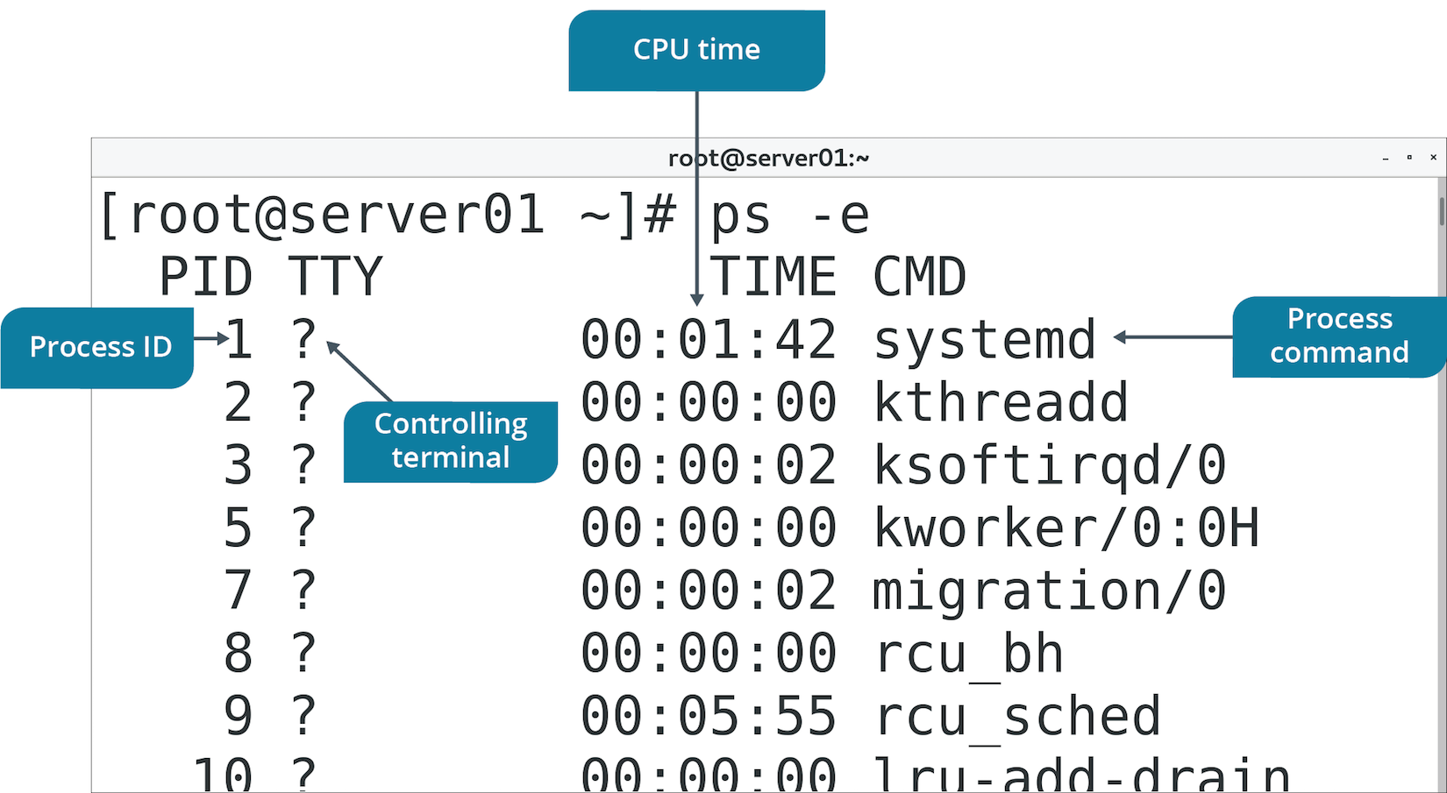
The ps Command (Slide 2 of 2)

Slide 84
The top Command (Slide 1 of 3)
Lists all running processes.
Enables you to manage processes interactively.
Dynamic process changes reflect real-time status.

Slide 85
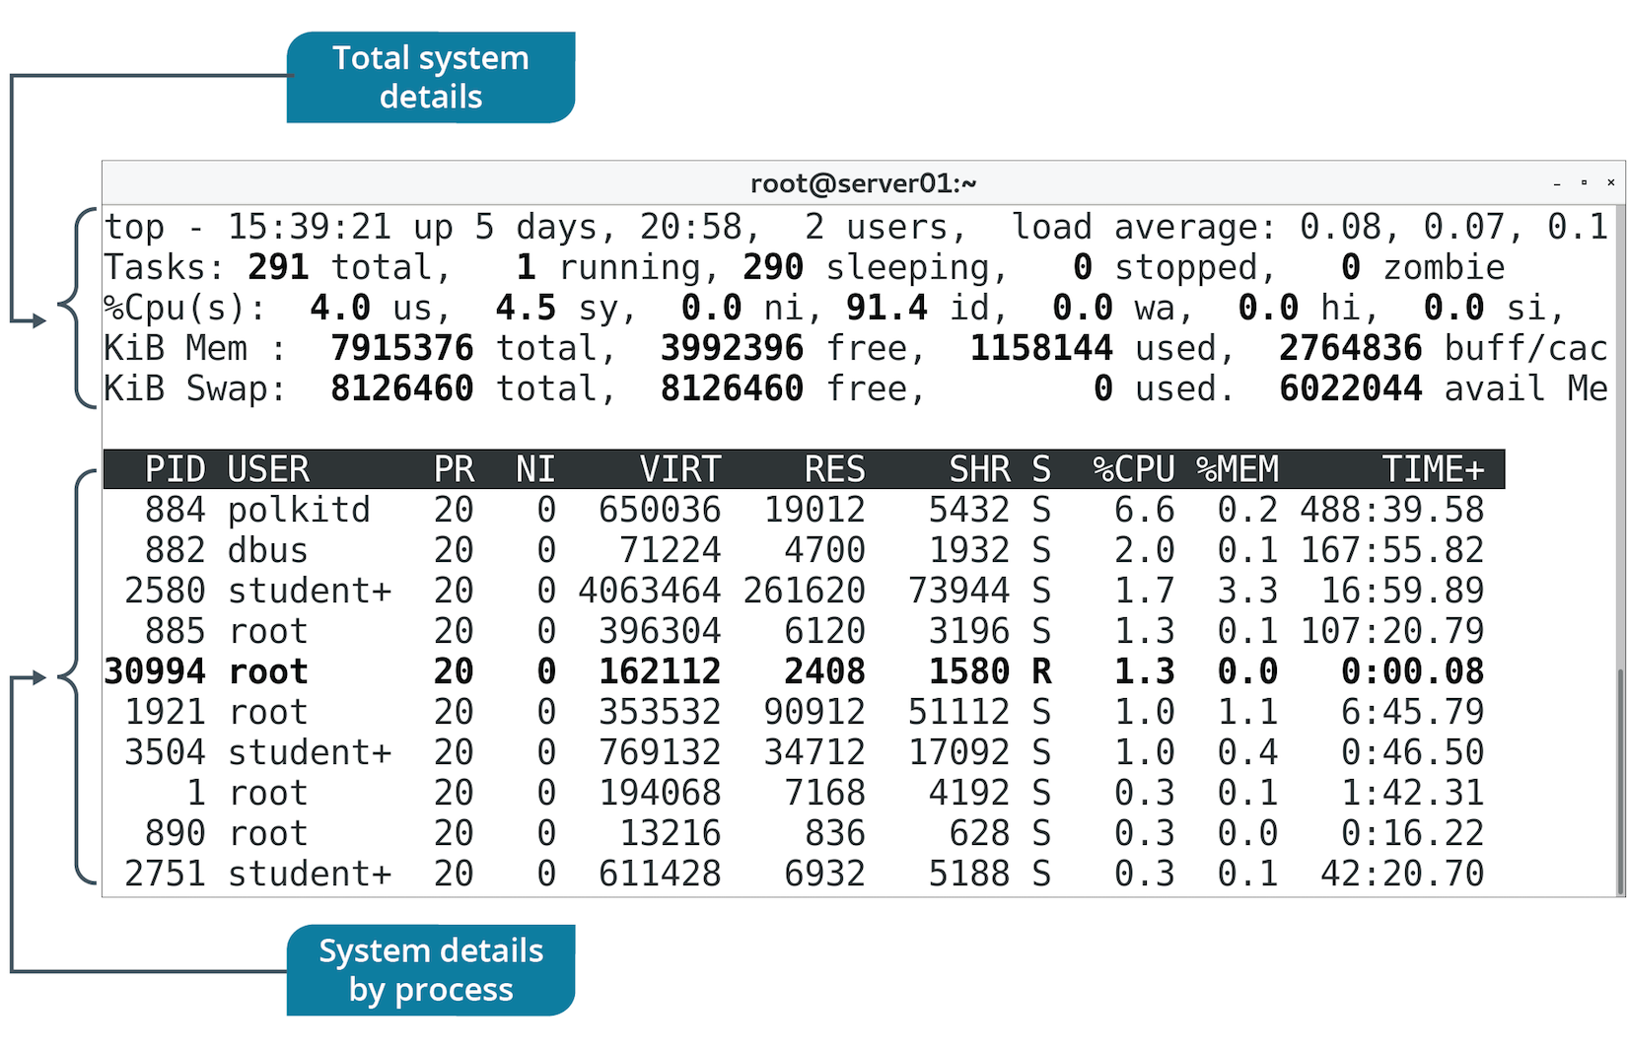
The top Command (Slide 2 of 3)

Slide 86
The top Command (Slide 3 of 3)
Key | Used To
Enter | Refresh status.
Shift+N | Sort processes by PID (decreasing).
M | Sort processes by memory usage.
P | Sort processes by CPU usage.
u | Display processes belonging to specified user.
k | Terminate a process.
r | Renice a process.
q | Exit the process list.

Slide 87
The systemd-analyze Command (Slide 1 of 2)
Retrieves performance stats for boot operations.
Takes various subcommands.
Most relevant subcommand for process management is blame
Prints all systemd units executed on boot.
Prints time it took to execute each unit.
Use to identify services/units that make system slow to boot.

Slide 88
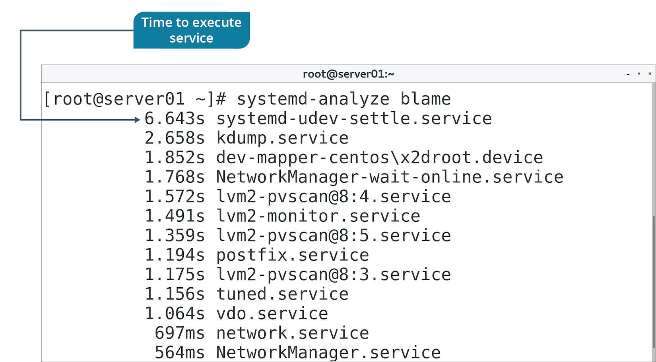
The systemd-analyze Command (Slide 2 of 2)

Slide 89
The lsof Command (Slide 1 of 2)
Prints all files open to all active processes.
Many different kind of files.
Use to identify process preventing you from modifying a file.
Use to analyze how a process uses files.
Prints:
Name of command/process
PID
Invoking user
File descriptor
Type of file
Name of file

Slide 90
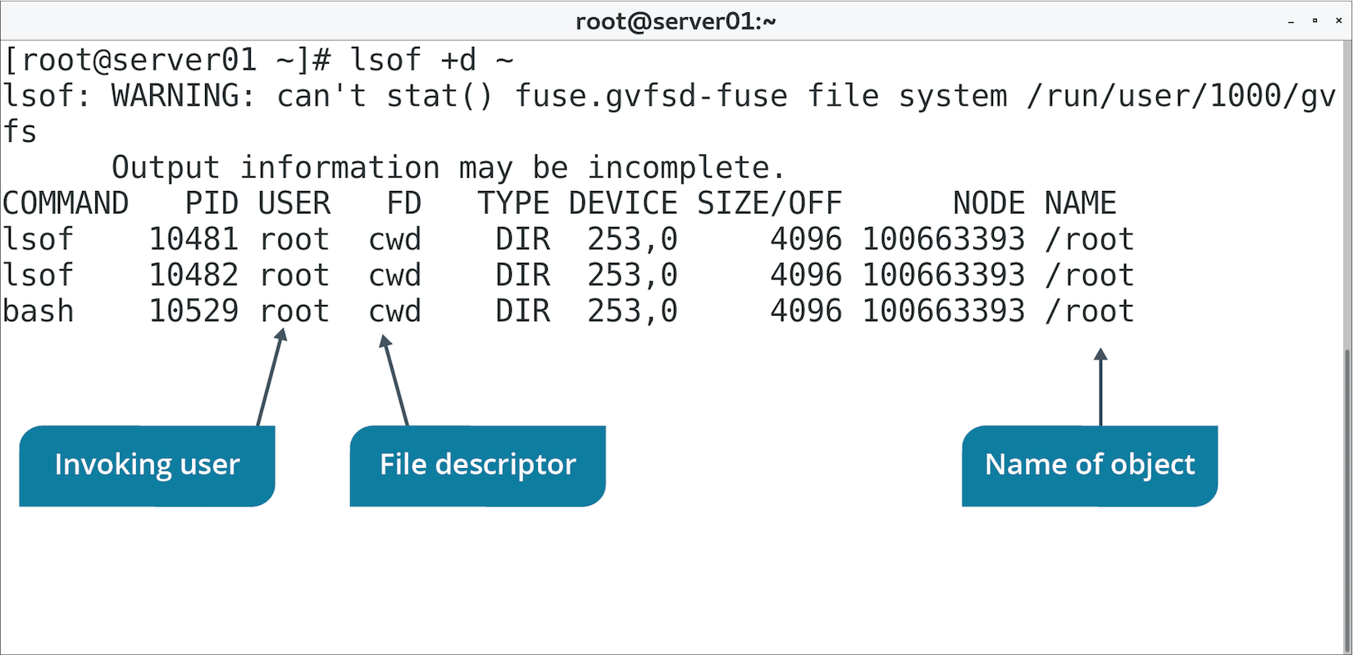
The lsof Command (Slide 2 of 2)

Slide 91
Process Priorities
Scheduler determines what processes to give CPU time to.
Not every decision is optimal.
You may need to manually prioritize processes.
One is more crucial than others.
De-prioritize process started by unprivileged users.
Process may be consuming too many resources.
Priority based on a nice value.
Number from -20 to 19.
Lower value is higher priority.
Process inherits nice value from parent.
Default is 0.
Notes:
Teaching Tip: It might help students to think of processes as being "nice" to each other by giving up their CPU time.

Slide 92
The nice Command
Run a command with a certain nice value.
The -n option increments nice value by given integer.
Assumes increment of 10 if no integer given.
Without options, prints default nice value.
Must have root privileges to run at higher priority.
Process with lowered priority can’t be raised by normal users.

Slide 93
The renice Command
Alter the nice value of an already running process.
Use -n to specify new nice value.
Identifiers:
Renice a process group with -g
Renice a user with -u
Renice by PID (default).

Slide 94
Foreground and Background Processes
Most commands execute in foreground.
Shell is "consumed" until process finishes.
Not a problem for simple commands.
Can be an issue for longer commands or scripts.
Example: Backup script can take 45 minutes to complete.
Won't be able to use same shell until it's done.
You can run commands in background.
Still execute, but don't consume shell.
fg/bg used to move commands to foreground/background.

Slide 95
Management of Foreground and Background Processes
Execute script in background (backup-script.sh &).
Use jobs to discover job ID of script.
Move script execution to foreground (fg %<job ID>).
Press Ctrl+Z to temporarily pause job.
Move script execution to background (bg %<job ID>).

Slide 96
The nohup Command
Prevents process from ending when user logs off.
Example: Admin executes backup script, then logs off.
By default, script would stop running.
Putting nohup in front of command will enable it to continue running.

Slide 97
Kill Commands
Used to terminate processes.
Unresponsive, cause instability, have open files, etc.
Command | Description
kill | Sends kill signal to one or more processes. PID must be specified.
pkill | Sends kill signal to processes based on pattern. Similar to pgrep but actually sends signal.
killall | Sends kill signal to processes based on name. Similar to pkill with some functional differences.

Slide 98
Kill Signals
Signal | Value(s) | Description
SIGINT | 2 | Interrupts process from terminal. Can be caught or ignored. Same as pressing Ctrl+C.
SIGKILL | 9 | Kills process immediately. Cannot be caught or ignored. Last resort.
SIGTERM | 15 | Terminates process. Can be caught or ignored. Sent from program and not terminal.
SIGSTOP | 17, 19, 23 | Pauses process. Cannot be caught or ignored. Sent from program and not terminal.
SIGSTP | 18, 20, 24 | Pauses process from terminal. Can be caught or ignored. Same as pressing Ctrl+Z.

Slide 99
Guidelines for Troubleshooting Process Issues
Gather info about processes, particularly their PIDs.
Use ps to print info on all running processes.
Use top to retrieve a dynamic and interactive list of running processes.
Use systemd-analyze blame to identify processes slowing down boot.
Use lsof to identify processes that have open files.
Use nice and renice to prioritize processes.
Use fg/bg to manage foreground/background processes.
Use nohup to keep command running after logoff.
Use kill to terminate problem processes.

Slide 100
Discussing Process Issues

Slide 101
Activity 8-7: Discussing Process Issues
One of the other system administrators on your team states that a process is now a zombie. What is the characteristic of a zombie process that makes it a problem for administrators?
ANSWER:
A zombie is a process that was terminated, but has not yet been released by its parent process. It is in a "zombie-like" state where it cannot accept a kill signal because the process isn't available anymore.

Slide 102
Activity 8-7: Discussing Process Issues
The Linux system that controls your phone system has experienced some problems with memory lately, and you're curious as to what the problem is. Upon further investigation, you note that the system is fully updated and patched. You decide to check running processes to determine if something has gone awry with one of the services. Which command can you use to check running processes?
ANSWER:
ps -aux

Slide 103
Activity 8-7: Discussing Process Issues
You've had several complaints about the performance of one of your systems. You log in and find that it responds slowly to commands. You want to look at processes that might be consuming too many resources. Which command can you use?
ANSWER:
top

Slide 104
Activity 8-7: Discussing Process Issues
While investigating complaints of system "slowness," you use the top command, but aren't seeing any issues from a CPU usage standpoint. You want to check memory usage while still using the top command. Which command key can you use to display processes by memory usage?
ANSWER:
M (uppercase).

Slide 105
Activity 8-7: Discussing Process Issues
It's 6:00 P.M. and you need to leave for the day. However, you also need to run an audit script that creates a report of all files that haven't been accessed in more than 180 days. If you log off, the script will stop running. How can you accomplish both—running the script and leaving work?
ANSWER:
Run the script using the nohup command: sudo nohup fileaudit.sh

Slide 106
Activity: Troubleshooting Process Issues
Some users have complained about processes taking too long.
Several processes were never successfully terminated.
You'll manage processes started by other users.
You'll also look for problem processes consuming too many resources.

Slide 107
Activity: Prioritizing Processes
You want to back up /etc directory
Copying process will be time-consuming.
You'll increases process's priority to ensure it completes on time.
Notes:
Teaching Tip: You may wish to have students read the following steps first, and then have them quickly execute the steps so they can renice the process before it finishes.
Teaching Tip: You may substitute another long-running command for this command, provided it will run long enough in your classroom environment to support the subsequent tasks.

Slide 108
Topic E: Troubleshoot CPU and Memory Issues
Exam Objectives:
4.1 Given a scenario, analyze system properties and remediate accordingly.

Slide 109
Common CPU Issues
CPU is under-performing.
CPU is being overloaded.
CPU cores are non-functional.
Process can't access enough CPU time.
Process accesses too much CPU time.
CPU spends too much time idle.
CPU doesn't support specific features.

Slide 110
The /proc/cpuinfo File (Slide 1 of 2)
Contains info about system's processor.
Identify characteristics that might relate to performance/functionality.
Each logical core has its own entry.
Each core represents a thread in multithreading CPUs.
CPU with 4 physical cores might have 8 logical cores.
Useful fields:
processor
vendor_id
model name
cpu MHz
cache size
flags

Slide 111
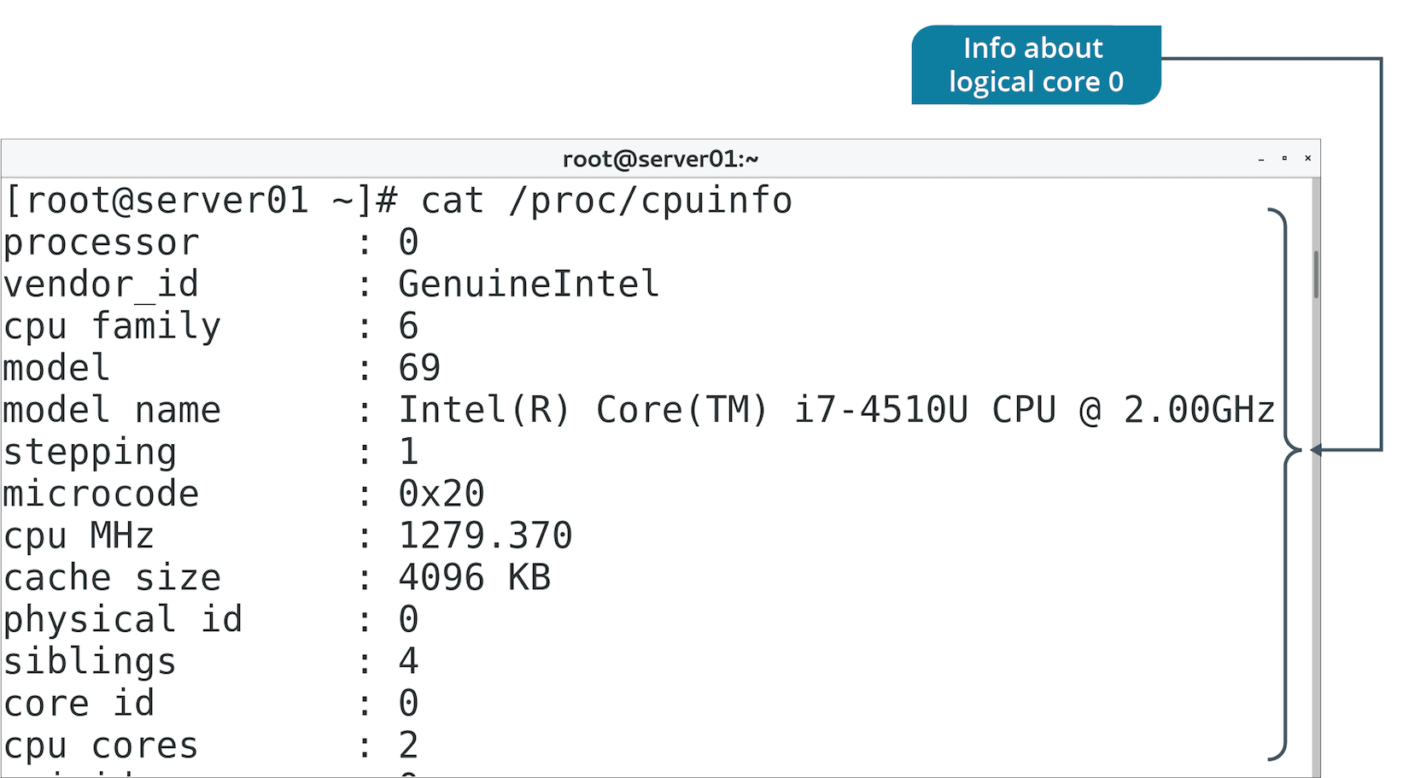
The /proc/cpuinfo File (Slide 2 of 2)

Slide 112
The uptime Command (Slide 1 of 2)
Displays time from when a system started.
Also displays CPU load average.
Load is the number of processes using/waiting to use CPU.
Find average load over a period of time (1, 5, 15 minutes).
Can indicate when CPU becomes overloaded.
Leads to performance issues.
Load average of 4.0 on 4 logical cores is full usage.
Load average of 8.0 on 4 logical cores is 100% overloaded.

Slide 113
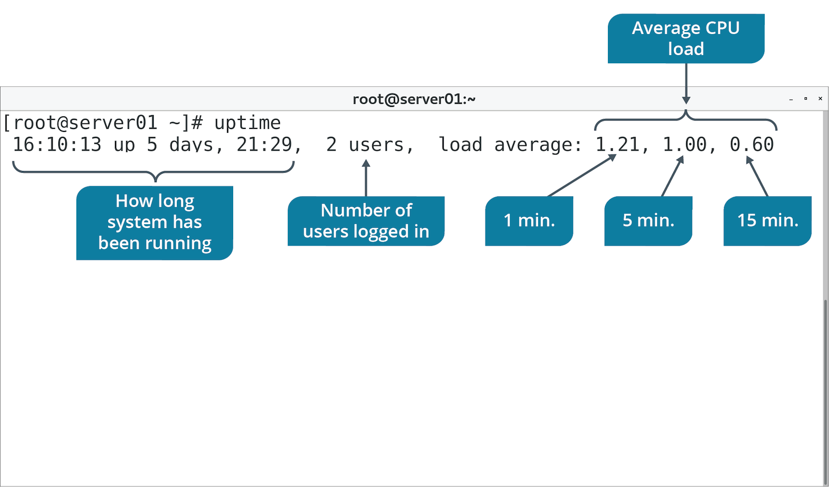
The uptime Command (Slide 2 of 2)

Slide 114
The sar Command (Slide 1 of 2)
Displays system usage reports.
Reports have various sections with data points and time of collection.
Default mode shows CPU usage.
For each time increment, shows load caused by a resource.
Resources are users, system, I/O, etc.
Average across times is displayed at bottom.
Default is to collect every 10 minutes.
You can use options to filter reports.

Slide 115
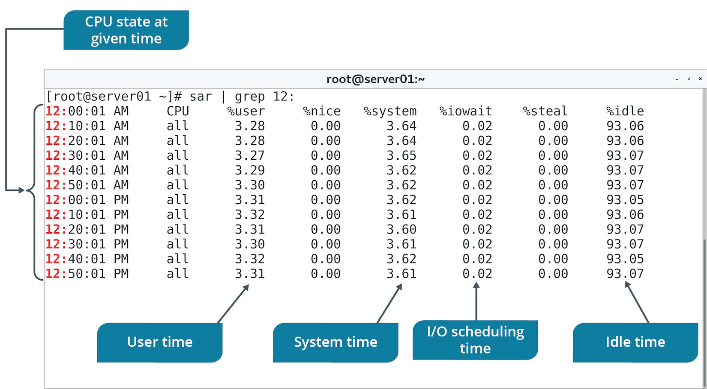
The sar Command (Slide 2 of 2)

Slide 116
Common Memory Issues
Not enough total memory.
Not enough free memory.
Process can't access available memory.
Process accesses too much memory.
System can't quickly access files from buffer/cache.
System is killing critical processes when low on memory.
Swap partitions take up too much/not enough space.

Slide 117
The /proc/meminfo File (Slide 1 of 2)
Contains info amount memory usage.
Use to ensure:
RAM is performing to spec.
OS is consuming memory at expected rate.
System has enough memory available.
Use fields:
MemTotal
MemFree
Cached
SwapTotal
SwapFree
Dirty
Writeback

Slide 118
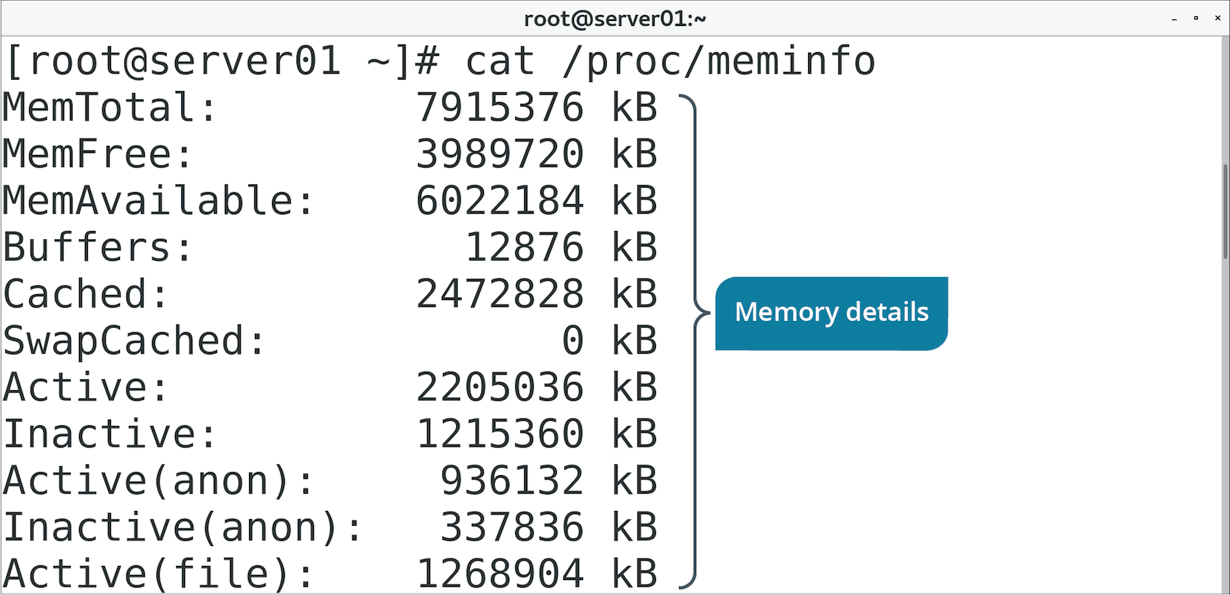
The /proc/meminfo File (Slide 2 of 2)

Slide 119
The free Command (Slide 1 of 2)
Parses /proc/meminfo for easier analysis.
Default output for memory and swap space:
Total
Total used
Total free
Total shared
Total buffered/cached
Total available for new apps

Slide 120
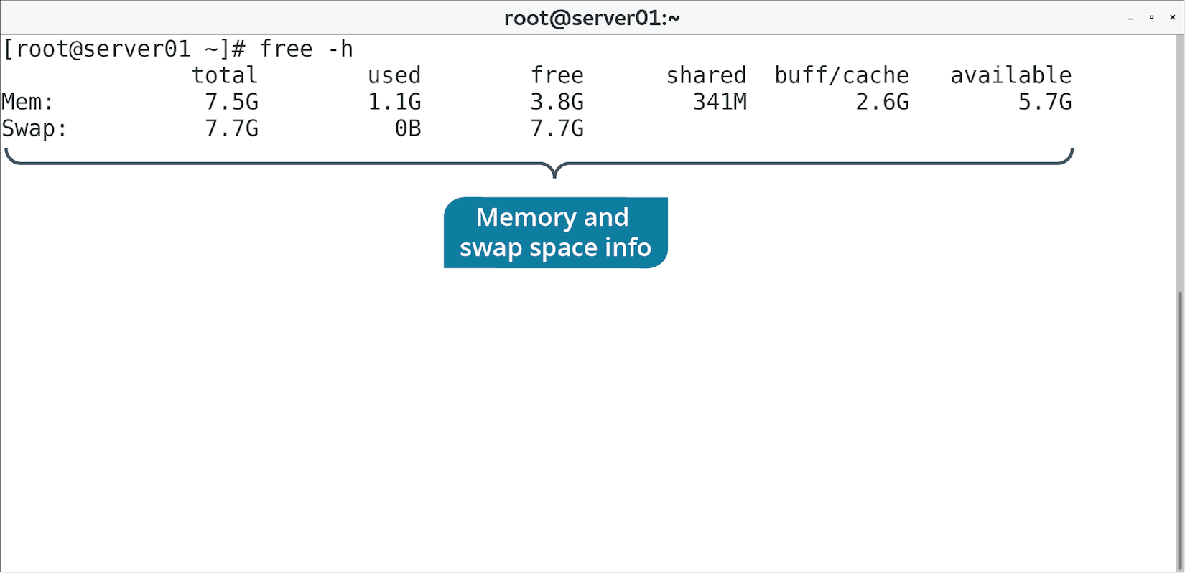
The free Command (Slide 2 of 2)

Slide 121
The vmstat Command (Slide 1 of 2)
Displays stats about virtual memory and other system resources.
Reports on averages since boot by default.
You can specify a delay value for a period of time.
Memory stats:
Total virtual memory
Free virtual memory
Virtual memory used in buffers/cache
Memory in swap space
CPU stats:
Time spent in user space
Time spent in kernel space
Time spent idle
Time spent waiting for I/O

Slide 122
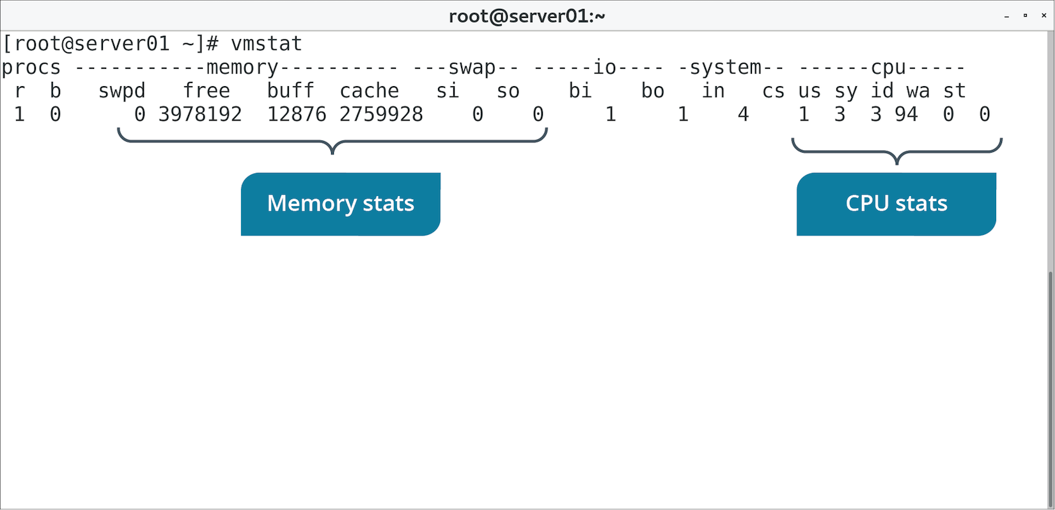
The vmstat Command (Slide 2 of 2)

Slide 123
OOM Killer
A feature of the Linux kernel that determines what process(es) to kill when the system is extremely low on memory.
Continues to kill processes until memory is free for smooth operation.
Uses an algorithm to determine optimal processes to kill.
Assigns each process an OOM score.
Higher the score, higher the chance of being killed.
Considers what will free up most memory and what will have least impact.
You can control its behavior if desired.
Mount oom control group.
Create directory and tasks file with PIDs of relevant processes.
Create oom.priority with high or low number to determine kill priority.

Slide 124
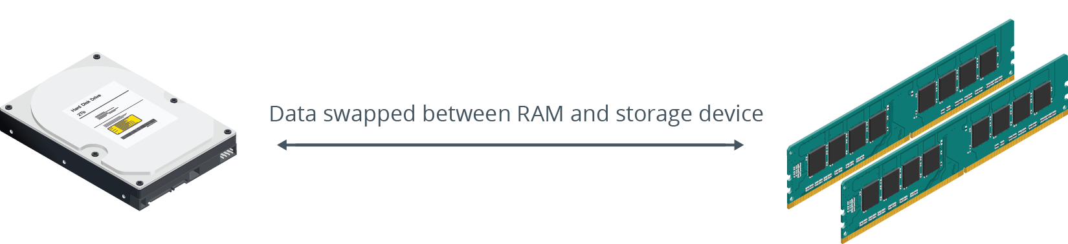
Swap Space Configuration
Can alleviate memory issues.
More important on systems with low RAM.
Not a replacement for adding more RAM.
Can still help with sluggishness/unresponsiveness/crashes.

Slide 125
The mkswap Command
Creates swap space on a partition.
Used when you want to move swap somewhere else (e.g., to save space).
Option | Used To
-c | Verify device is free from bad sectors before mounting swap space.
-p | Set page size to be used.
-L {label} | Activate swap space using labels.

Slide 126
Swap Partition Management Commands
swapon activates a swap partition.
swapoff deactivates a swap partition.
Option | Used To
swapon -e | Skip non-existent devices.
swapon –a | Activate all of swap space.
swapoff –a | Deactivate all of swap space.

Slide 127
Guidelines for Troubleshooting CPU and Memory Issues
Identify key CPU info from /proc/cpuinfo
Use uptime to identify CPU load averages.
Use sar to see what is causing CPU load and when.
Identify key memory usage info from /proc/cpuinfo
Use free to analyze memory usage info.
Use vmstat to retrieve CPU and memory usage info.
Consider tweaking OOM killer for your needs.
Consider creating more swap space.

Slide 128
Discussing CPU and Memory Issues

Slide 129
Activity 8-10: Discussing CPU and Memory Issues
For a quick glance at CPU performance, what does the uptime command tell you about the system?
ANSWER:
The uptime command displays the CPU's load average for the last 1, 5, and 15 minutes.

Slide 130
Activity 8-10: Discussing CPU and Memory Issues
The Performance and Capacity Team in your company requires a system activity report on one of your Linux systems. The team contact has requested a CPU report. Which command can you issue to gather the information for the report?
ANSWER:
The sar -P ALL command gathers CPU statistics for all CPUs.

Slide 131
Activity 8-10: Discussing CPU and Memory Issues
Some of your users have complained about one of the development servers being slow. With what command can you check the memory statistics that give you the best quick snapshot of memory performance?
ANSWER:
free -h -t gives you a complete look at memory performance in human-readable format. This also includes used swap space, which is important for determining if a system has serious memory issues.

Slide 132
Activity 8-10: Discussing CPU and Memory Issues
The vmstat command is useful for displaying an overall performance snapshot, but running it once only displays information since the last reboot. How can you see a more comprehensive view of system performance using the vmstat command?
ANSWER:
The standard command to see system performance statistics using the vmstat command is vmstat 5 5 —This provides you with a comparison view from last reboot and four updated snapshots.

Slide 133
Activity 8-10: Discussing CPU and Memory Issues
You may configure swap space on a Linux system but not necessarily make it active until you feel like the system requires it. How can you enable a system's configured swap space?
ANSWER:
The sudo swapon -a command activates all configured swap space on a Linux system.

Slide 134
Activity: Troubleshooting CPU and Memory Issues
You want to identify tools to help manage system components.
You'll review processor and memory usage.
Ensure results match expected performance.
Notes:
Interaction Opportunity: Throughout this activity, encourage students to share the results of the commands they enter. The results will usually vary based on a number of factors, particularly the underlying hardware.

Slide 135
Do you prefer administering your Linux systems in a GUI environment, or just from the CLI? Why? If you prefer working in a GUI, which desktop environment do you prefer to use?
Which process management tools do you expect will be useful in your environment? Why?

